Slide 1

How to present a research paper?
KSCASI Webinar
12 March 2026

Slide 2
Part 1
Planning the talk
Part 2
Tips to win an award
Mistakes to be avoided

Slide 3
Part 1
Planning the Talk
Dr K Lakshman
Bangalore

Slide 4
Plan
Planning the content
Preparing the slides
Preparing for the presentation

Slide 5
Planning the content

Slide 6
Goals of a Presentation
Grab attention
Give messages
Help retain messages

Slide 7
Good Presentations
Art and science
Natural gift rare
Planned learning
Practice / Diligence
Doesn't “just happen”

Slide 8
Presentations - the basics
Nothing can make up for lack of content
Story board - logical sequence
Setting the ‘tone’
Audience involvement

Slide 9
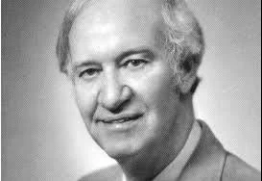
Good presentations are a partnership - not a monologue
Malcolm Knowles

Slide 10
Learning presentations
Lessons from advertising
Define messages to be given
Restrict to 4-5 points
“Story Board”
Give a summary first
Repeat “messages”

Slide 11
Crucial issues
Take note of the time allotted
Restrict number of slides to about 1 per minute
Exceptions
  Do not count the title and ‘thank you’ slides
  One may also ‘run through’ pictures
Use tables and graphics to reduce the number of slides

Slide 12
Designing the slide

Slide 13
Slide Design
Template Sedate / Appropriate
Fonts 28-44 pt / Sans serif
Graphics Relevant / simple
Colour Scheme Sedate
Transitions Simple
Build effects Mild / not fancy
Sounds Minimal / Not at all
T
T

Slide 14
Template / Fonts
Dark background and light fonts
Light background and dark fonts
Enough contrast
Design, if any, must be subtle
Fonts of appropriate size for the hall
Highlights by underlining or bold letters or Italics or larger fonts or shading

Slide 15
Text
Must be bulleted points – not whole sentences or paragraphs
The ‘Rule of Six’
The text must give you cues
You give the explanation – never ‘read’ a slide
Details in the ‘notes’ if needed.
Practice makes this unnecessary

Slide 16
Graphics and colours
Use photos and videos liberally
Simple and appropriate graphics
Using own photographs
Beware copyright issues if downloaded from the net
Keep text to a minimum when graphic is used
Sedate colours
Avoid pink, red and light green

Slide 17
Transitions
It is the way one slide moves on to the next
Wide variety available
Use only subtle transitions, if at all
Do not use the ‘Exciting’ or ‘Dynamic content’
Do not use if the next slide has ‘build effects’

Slide 18
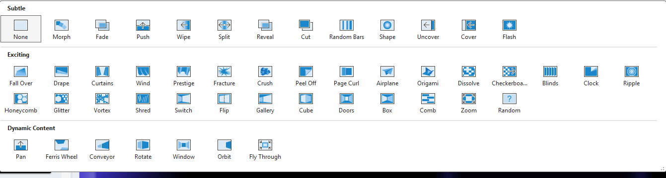

Slide 19
Do NOT do this!

Slide 20
Or this!

Slide 21
Build effect / Animations
It is the way in which different parts on the slide appear
Used to highlight issues
Must not be jarring or fancy
Focus is on keeping the attention on you
Slide is only an adjunct

Slide 22
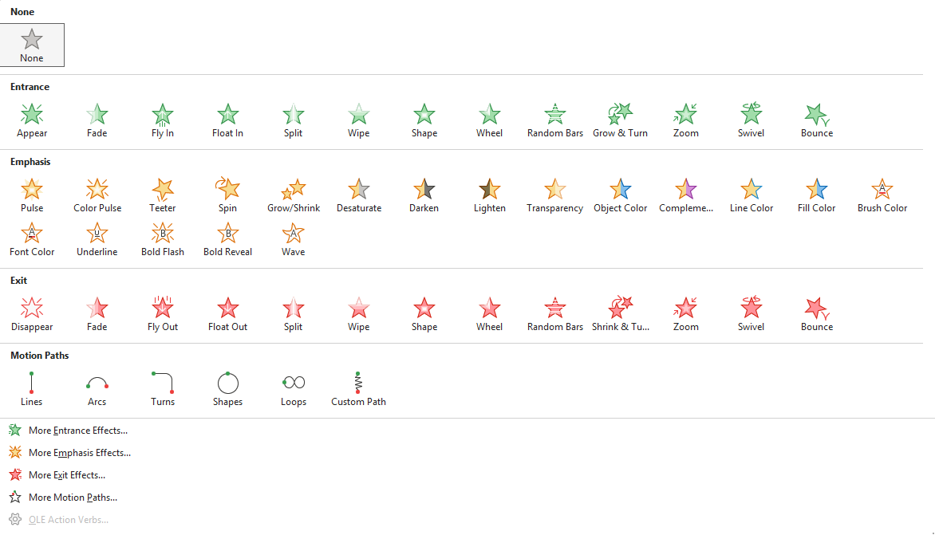

Slide 23
Do NOT do this
Or this
Or this
Or this

Slide 24
Preparing for the presentation

Slide 25
Remember
Rehearse , Rehearse, Rehearse
Attention to diction and time
In front of a mirror or with friends
Record the rehearsal and listen to it
Invite critique and change accordingly
Fonts may not match in the presentation computer
Save fonts along with the presentation

Slide 26
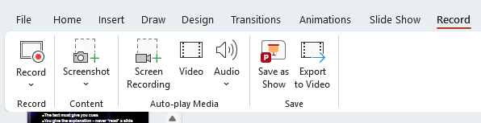

Slide 27
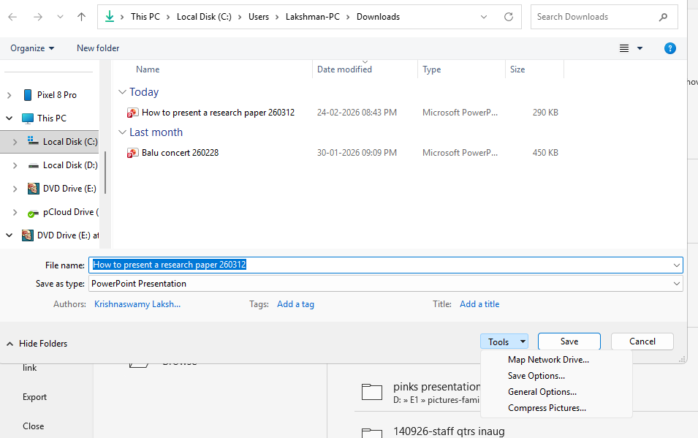

Slide 28
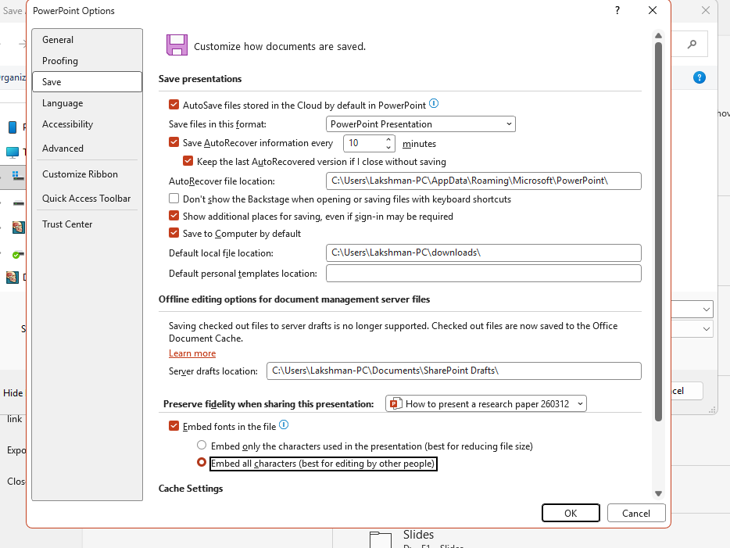

Slide 29
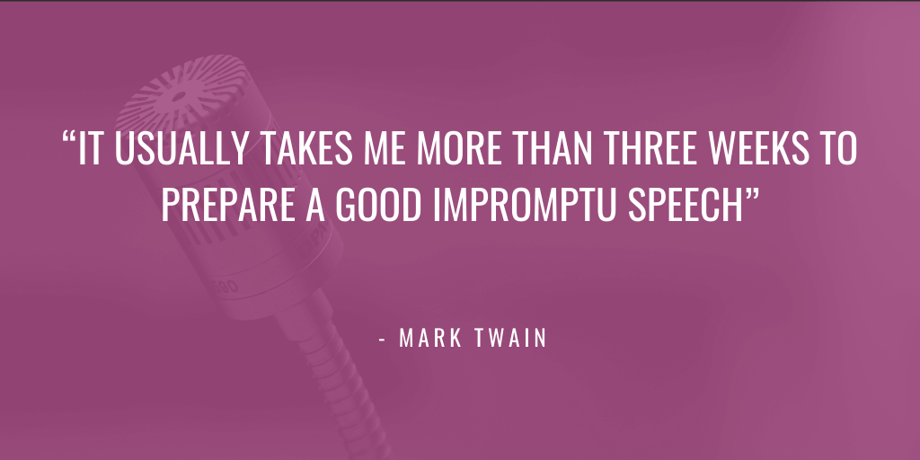
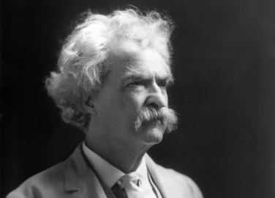
Thank You

